Slide 1
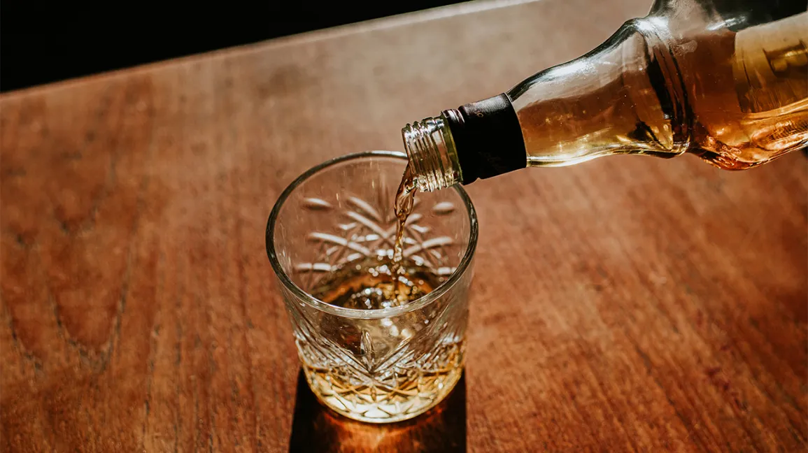
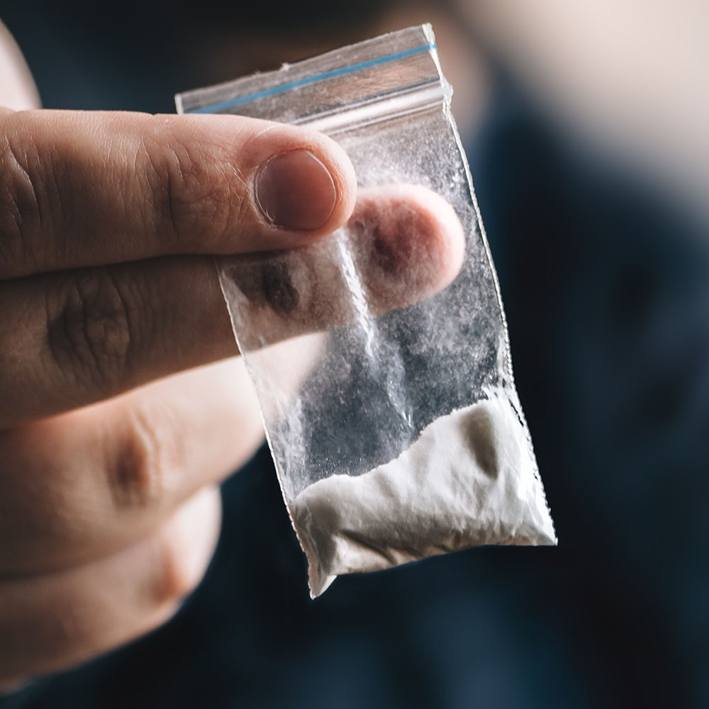
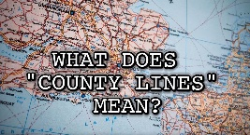
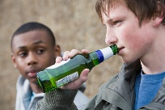
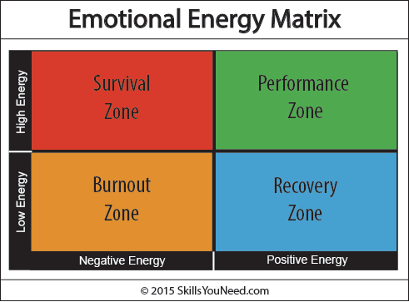
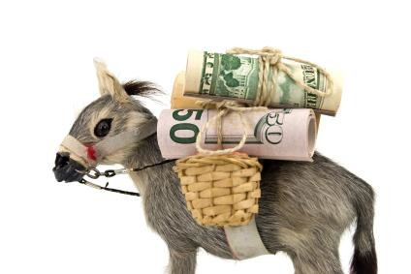
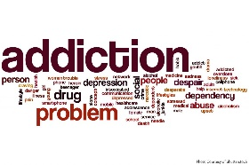
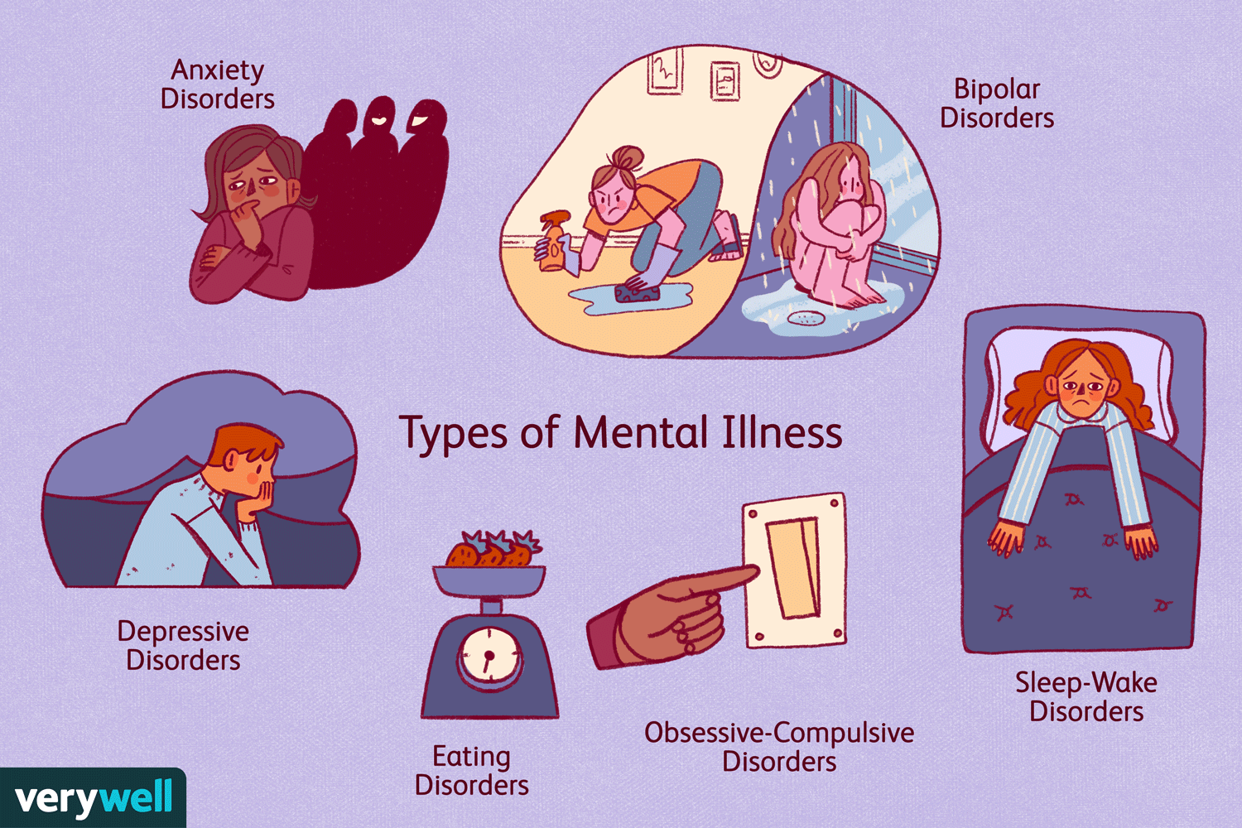
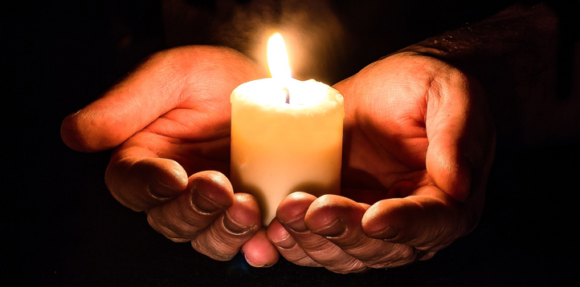
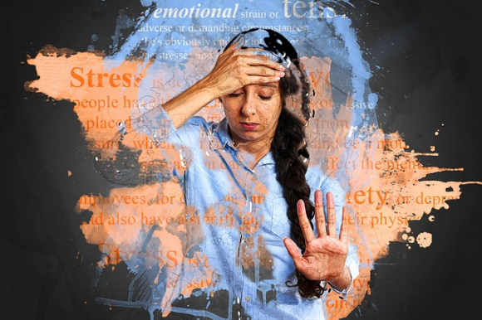
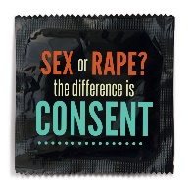
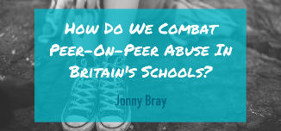
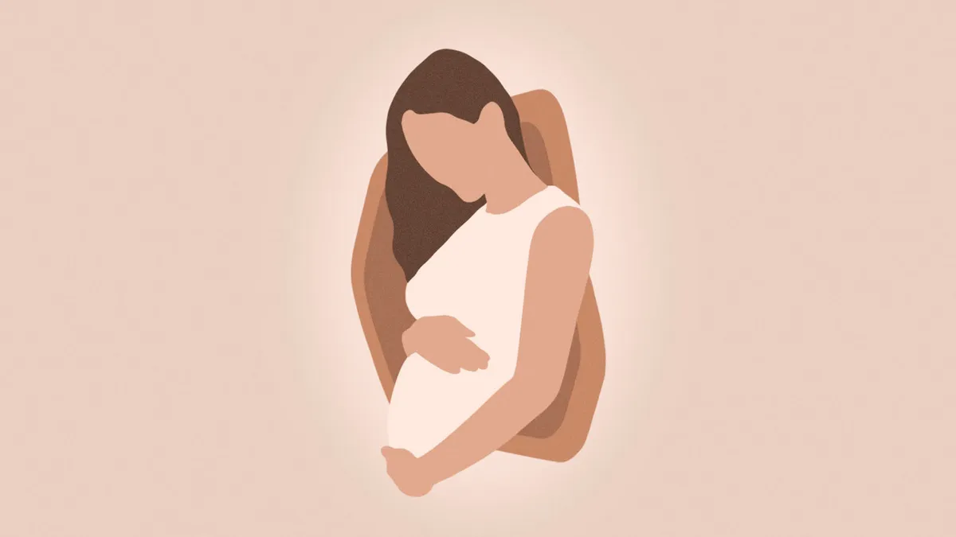
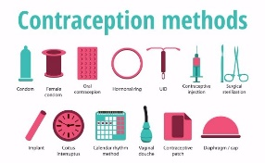
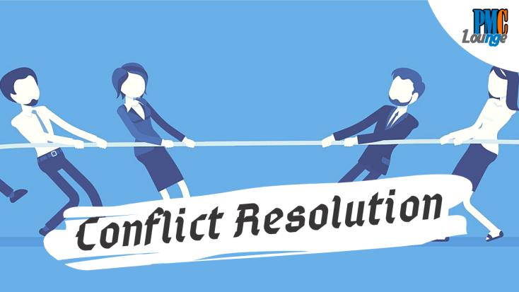
KINGS LANGLEY Y11 PSHE LEARNING JOURNEY
Planning for my future
Money stresses & pressures.
Equality Act
Prejudice
Breast and testicular cancer
Year
12
Alcohol and other drugs
country lines and cuckooing
Alcohol and the law.
Being safe online
Addition and dependency.
Managing risks
Money mules
Types of fraud
Positive mental health
Loss and bereavement
Recognizing signs of mental illness
Negative thinking patterns
Mental health challenges
The role of intimacy
Pornography
Peer Pressure and coercion
Pregnancy choices and abortion
Pregnancy outcomes
Fertility and Parenthood
YEAR
11
Long term commitments
Conflict resolutions in relationships

