Slide 1
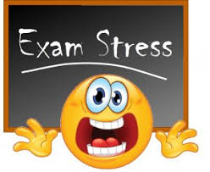
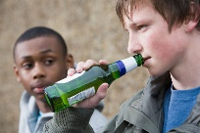
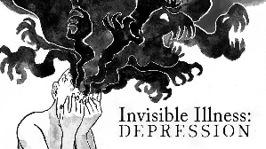
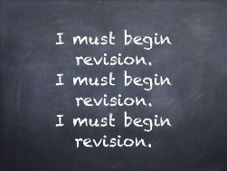
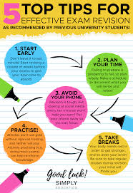
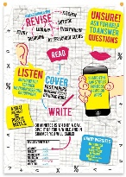
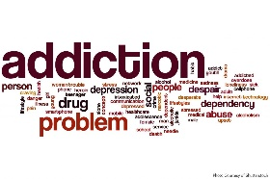
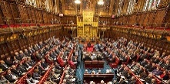
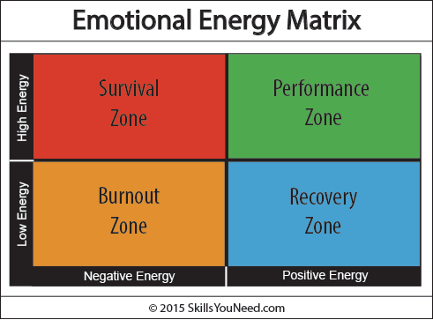
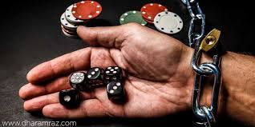
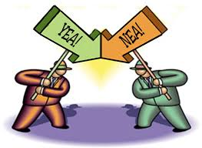
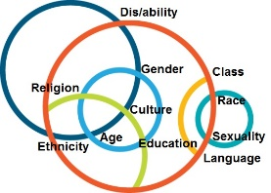
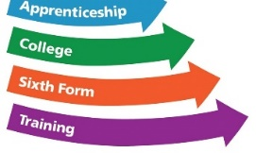
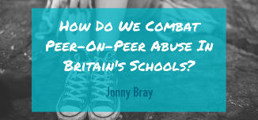
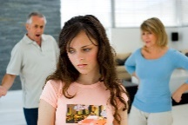
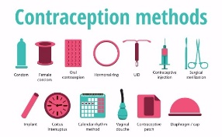
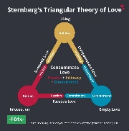
KINGS LANGLEY KS4 PSHE LEARNING JOURNEY
Work experience
Money stresses & pressures – credit cards
Consumerism
Year
11
How addictions affects families
Stress, pressure & exams
Coping with mental health
Drugs supply chain and country lines
Alcohol and young people
Depression
What is addition?
Recognising & balancing emotions
Revision strategies
Revision strategies
Revision strategies
Revision strategies
House of Lords – do they need to reform?
Gender and Language
Gambling addiction
Having a say
Taking part in a debate
Challenging discrimination
Democracy
Voluntary work
Employability
Writing a CV
Apprenticeships & post 16 options
Shared identity and experiences – Diversity in Britain
Unifrog
Grooming & sexual exploitation
Sexual health (sexually transmitted infections)
Peer to peer sexual abuse
Consent & rape
Domestic violence (when relationships go wrong)
Different types of contraception
Tensions between teens and parents
Parenting skills and family tree
YEAR
Divorce – when relationships break down
10
Different types relationships
Different types & levels of relationships

